Slide 1
Software engineering
 Team 8 - Skooba
-Fedor Semaev
-Sigurd Myrnes Uhre
-Jørgen Eriksen Løken
-Eivind Østlyngen
-Magnus Dahl-Hansen

Slide 2
Overview
Demonstration
Software development practice
Lessons learned

Slide 3

Skooba - Training application with selective and suggestive workouts
Product vision
What is Skooba?
What is unique about the product?
How does it stand out?
User stories
Used to derive new features
As a <role>, I <want/need> to<do something>
Agile relationship to features
New ideas can be added
Old ideas can be removed
SCRUM based approach (our own version)
Notes:
1: Introduce the app as it is now. “What is skooba?” 2: Say how we came out with the product vision(Brainstorming first week, everybody voted for ideas)
3: Say how we fleshed out the idea (Defined User roles, target users => personas(?), stories) and checked viability(Is there a user need?) 3.1 Some stories/features were dropped underways and some were added, omg so agile hehe. We have developed a workout application which allows the user to create custom and random workouts, save, replay and delete the workouts and . The user is able to
The goal of the project is to develop a workout-application that gives the user opportunity to insert
training criteria into the application and receive a proposal for how the training session might look,
based on these criteria. The training session must then be able to be carried out with available infor-
mation and timing. The purpose of the app is that it adapts to and inspires the user’s training session.
The product to be developed is a workout application which allows the customer to enter simple
preferences for what kind of body part, how much time, and in what combination they want their
training session to look like. The customer must be able to choose the extent to which they will de-
cide what to train through options such as totally random training session, partially random training
session, and complete control over the training session.
Compared to other products on the market, this product is based on what the customer wants the
training to contain, and not what are necessarily recommended combinations from personal trainers.
This product gives total control to the user, and sets no restrictions on the combinations. One of the
key visions of our software is that the customer should be inspired to do new exercises, but at the
same time they are left with the freedom of choice to decide which body part they want to train and
for how long they want to train it. Users of all ages who want inspiration and training on their own
terms are the targeted users.

Slide 4
Demo: Register & Login/out
As a: user
I want to be able to: register as a new user
So that: I can save, delete and replay workouts
Notes:
In our application, the users have the ability to register a user and log into it. This is covered by the user story, that as a user, i want to be able to register a new account so that i can start to access all the features provided by the application, such as the saving, deleting and replaying workouts. Therefore, the user will want to have an account with a unique username followed by a password so that only the user can access the account.
As you can see from the demo, the user can register an account providing an unique username and a password along with it. Upon submitting, this account is saved to the database.
When the user wants to login, he or she can provide the correct username along with the corresponding password in order to get access to the account.

Slide 5
Demo: Create random workout
As a: User
I want to be able to: Create a random workout
So that: I can generate a good and effective workout without having to plan the workout myself
Notes:
Create random workout is a one of the main features in this project, and covers a user story where the user wants to be able to create a random workout, so the user don't have to spend time on planning the workout, and wants a simple training application. Therefore we created a feature called “generate random workout” where the user chooses which workout type and muscle group the user want to train, in addition to duration. There is possibility of choosing random on all fields except duration, but in order make this feature broader so more users would use this feature, partially random workout is also possible. Where the user can chose partially random workout for example they want to train high volume training, but they dont know what part of body. Or on other hand if they want to train chest and legs but dont care about what type of training.
Create random workout is a one of the main features in this project
User story
To satisfy this story we developed a feature where the user can choose what workout type, muscle group and duration the user want to train. For example, the user can choose “random” on both of the fields as seen at the illustration, in order to generate a random workout. In order to satisfy both less experienced and more experienced users, we have partial random workout. Which allows the users to choose what type or which muscle groups to train. For example, the user want to train “legs”, but is tired of his old wokrout. Therefore he can generate new workout which covers his original program. And for create workouts for more experienced users which for example knows what bodyparts to train but is tired of his usual workout.

Slide 6
Demo: Create custom workout
As a: User
I want to be able to: Create my own workout
So that: Create a workout with specific exercises, repetitions, sets, rest time between each set.
Notes:
Other than random workout, we also have custom workout. This is covered by the userstory that, as a user i want to create a workout that is tailored to my specific needs and goals. So that i can create a workout with specific exercises, set the number of repetitions and sets and choose the rest time between each set. Moreover, as a well experienced user, who may already have a designated workout plan, he or she can easily input the exercises from that workout plan, into our application.
Therefore, the custom workout feature was implemented for this exact purpose. As you can see from the demo, the user can choose different exercises from the specific muscle groups. The exercises from each of these muscle groups are gathered from the database. So if a user want to create a workout for chest day, they can easily choose exercises from the chest muscle group button. These are added to a table that is visible to the user, so that the user can get an overview of the chosen exercises. Here they can set the number of repetitions and sets, as well as the rest time between each set. The user can also reorder the exercises in the order they want the workout to start in, and delete an exercise if they want to do that. Upon clicking the create workout with the given workout name, the workout will be saved to the database, associated with the user’s id.

Slide 7
Demo: Saved workouts
As a: user
I want to be able to: Replay and delete workouts
So that: I can remove bad workouts and repeat good workouts

Slide 8
Demo: Simulation & Info
As a: user
I want to be able to: Simulate through the generated workout and see info about exercises
So that: I can easily track the number of reps, sets and rest-time.
Notes:
Easily track the number of sets in exercise, and what exercise to do next
Inexperienced user can also get step by step instructions on how to perform the exercise

Slide 9
Demo: Navigation Bar
As a: user
I want to be able to: Navigate the website efficiently
So that: I don’t have to spend unnecessary time navigating to each functionality.

Slide 10
Software development practice - SCRUM
Our own version of SCRUM
TA: Product owner
Development team = Self-organizing team
Scrum Master
Inspire the use of SCRUM methods
Organize
Periodically rolled on
Remaining team members
Developers
Product backlog items (PBIs)
Item (task/feature)
Arranged by “most important first”
Notes:
Hva: How we structured our agile programming using scrum. Introduce the roles of product owners, developers, scrum masters etc Introduce the backlog (Mention the google docs as a backlog?)

Slide 11
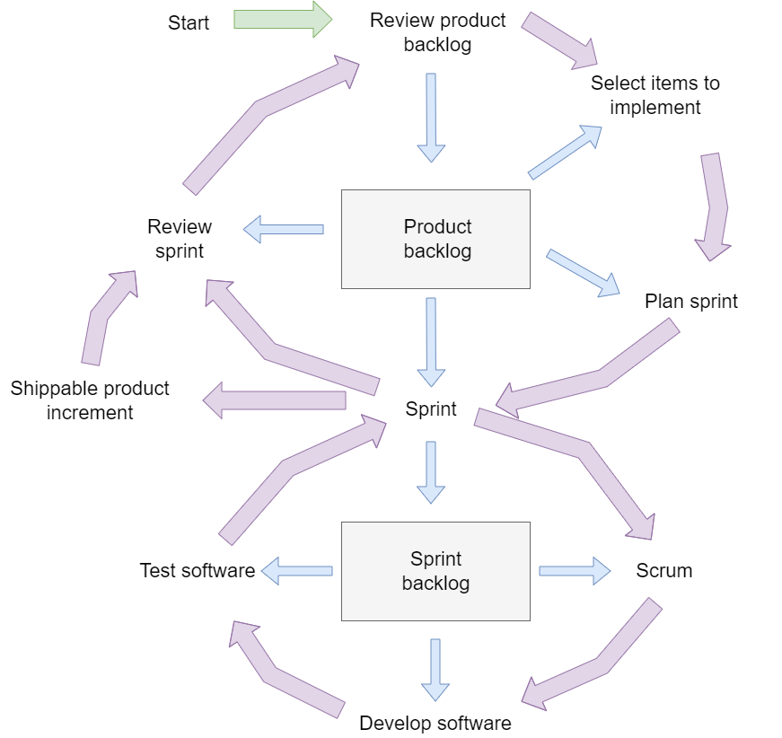
SCRUM-Sprint
Sprint
Scrum cycle as inspiration (picture)
Typically (1-3 weeks)
Weekly meeting
Scrum-meeting (Standups/plan/discuss work)
Working together
Sprint planning
Item from PB
Product backlog review
Created sprint backlog (tasks/features)
Notes:
How our agile development, introduced in the last slide, worked on a weekly basis

Slide 12
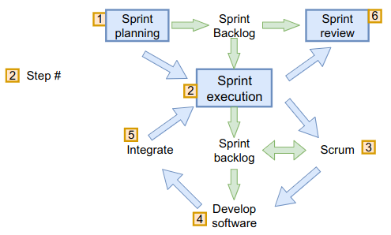
SCRUM-Sprint
How to choose and estimate sprint-tasks:
Effort required (1 point = 2 hours)
Personal preference/experience
Sprint execution
Scrum-meeting (standups)
Update sprint backlog (if needed)
Develop software
Integrate (merge branches)
Sprint review (retrospective)
What worked and what didn't?
Code review (!)
Unfinished items:
Placed back in the PB

Slide 13
Other methods
Pair programming
Kanban board
Milestones
Communication
Weekly meeting
Discord
Notes
Google document
Git

Slide 14
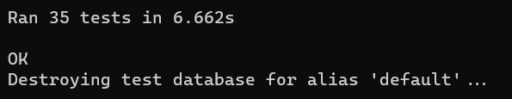
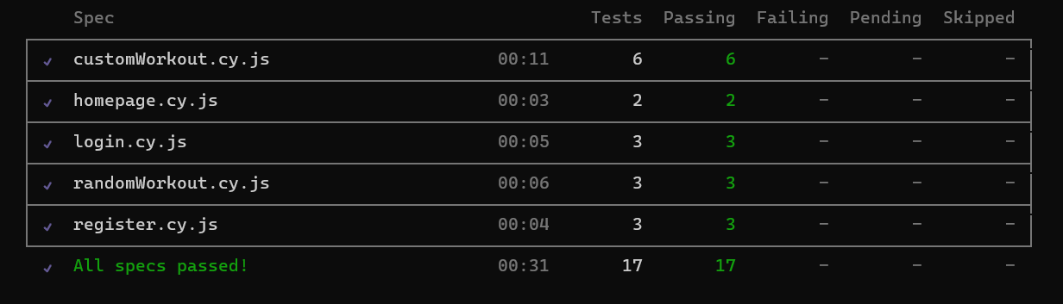
Testing
Unit tests
Integration tests
System tests
TDD
Industry software
Notes:
To ensure the functionality of the program, we have implemented tests at all levels of the system.
Some levels were weighted more than others. (?)Test driven development was not weighted, but they were more written after the fact to validate functionality among other components or when struggling

Slide 15
Lessons learned
Give more responsibility to the SCRUM master
Choose a standard for directories layout
Create a detailed product backlog and maintain it
Familiarize ourselves with methods and tools at start phase
Scrum, GIT, Typescript, code standard
Notes:
Throughout the project we learned some main points which we want to take further for the next projects. One of the mains lessons learned is that we have to establish one main scrum master, since in the beginning the scrum master had responsibility to plan meetings, take notes and distribute information. As the process went further, the SCRUM master role was forgotten, where each team member contributes as they wanting by taking initiative. Although this method did work for us, the development process was generally more effective with a SCRUM master having responsibilities. Another lesson learned is that we want to have more different frameworks has a standard directory layout, and when combining them the directories getting messed up.
Throughout the project we learned some main points which we want to take further for the next projects.
Another lessons learned is to agree on a directory layout before starting on the project, since we had no standard directory layout therefore as more components and frameworks like testing framework were introduced, the directory layout became unorganized. An other lessons learned was to create a detailed product backlog and maintain it, in our case the backlogs was not as detailed and often took multiple sprint to satisfy an item. In addition to that the backlog could be more maintained during the projects, for example if a task was not finished it did not go back to backlog but rather carried over to the next sprint, which took away the incremental development. The last lessons learned was to familiarize ourselves with methods and tools at start phase, since we did not do the research needed about the technologies we used during the project, and just started at the so we ended up using time on learning the tools instead of just coding, in addition we could have implemented more efficiently code. But we still manage to complete our projects, those lessons would make the development process easier.

